Slide 1

February 12, 2012

Slide 2
House Keeping
Court Coverage:
During pre-game conference discuss court coverage. Especially where the lead will pick up the ball and the trail going off ball. (And, vice-versa.)

Slide 3
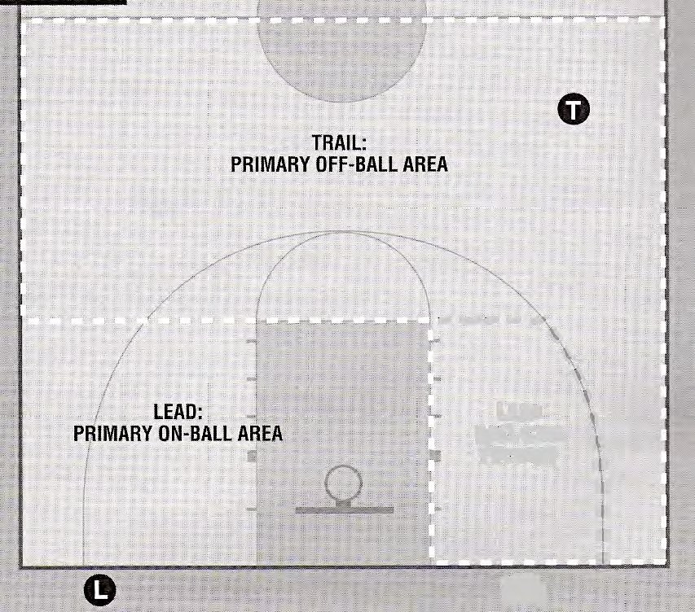
Court Diagram

Slide 4
House Keeping
Ending of the season is rapidly approaching:
Modified games are upon us – be aware of the pressing rule and use proper mechanics.
Sectionals - A good pre-game is essential

Slide 5
Throw-in Scenario
On a throw-in, the referee has begun the 5 sec. throw-in count and A1 fumbles the ball. It bounces out of the designated throw-in spot. A1 requests a timeout. Should the official grant the time-out?

Slide 6
The official shall NOT grant this timeout.
A time-out shall be granted ONLY when a player of that team is in control of the ball (This includes throw-ins and free-throws.) 5-13.1a
Ignore the time-out request and re-administer the throw-in. 4-31.1 & 7-6.5

Slide 7
SHOT AT THE END OF A PERIOD:
Almost always the TRAIL'S CALL. During pre-game conference – Talk over who will take LAST SECOND SHOT.
… Long pass and quick lay up or jump shot …… 3 point shot from the LEAD'S area.
In the last minute, you and your partner should signal 1 minute left in quarter by putting up one finger.
When the shot clock is approaching the last few seconds the trail, should signal (pat to the chest) I have the shot call.
If a shot goes up so does your signal with the number of fingers (two or three) it will be worth if it scores. If the shot is not released in time wave it off immediately, don’t wait to see what happens.
2007 NYSGBO Two Person Mechanics Manual, p. 20

Slide 8
Electronic Equipment on the Bench
Computers (Ipad is a computer) and other electronic transmissions are not to be used for coaching purposes. However, they are allowed to use it to keep stats.
Rule 10 - 4.2 Bench Technical Fouls shall be assessed

Slide 9
VIDEO CLIPS
End of game/shot clock responsibilities
NCAA Video

Slide 10
Questions and Answers

Slide 11
Good luck and finish the season strong.
Safe travels

