Slide 1
Welcome
February 13, 2011

Slide 2
Modified Update
Keep in mind the following:
Review the modified handout that I distributed last month
Be aware of the # of quarters/periods and allotted time-outs
Give yourself enough time for a pre-game meeting
Use proper switches/rotations when calling fouls and violations
Using proper mechanics
Being professional with coaches

Slide 3
Sectionals
If you are assigned a “Sectional Game” Congratulations.
Keep in mind that there are fewer officials working then not working. So …
Be professional
Have a good pre-game meeting
Work hard throughout the entire game
If you are assigned as an alternate you are part of the officials’ crew. (Pregame, score table, extra set of eyes and ears for referee and umpire.)
Remember you are representing the Syracuse-Oswego Board of Women’s Basketball Officials.

Slide 4
Post Play
Be aware of off-ball coverage.
Both offensive and defensive post players are wrapping, holding, and clamping to gain an advantage on their opponent.
We need to see the entire play, from the beginning to the end to make the correct call.
Call a double foul if needed.

Slide 5
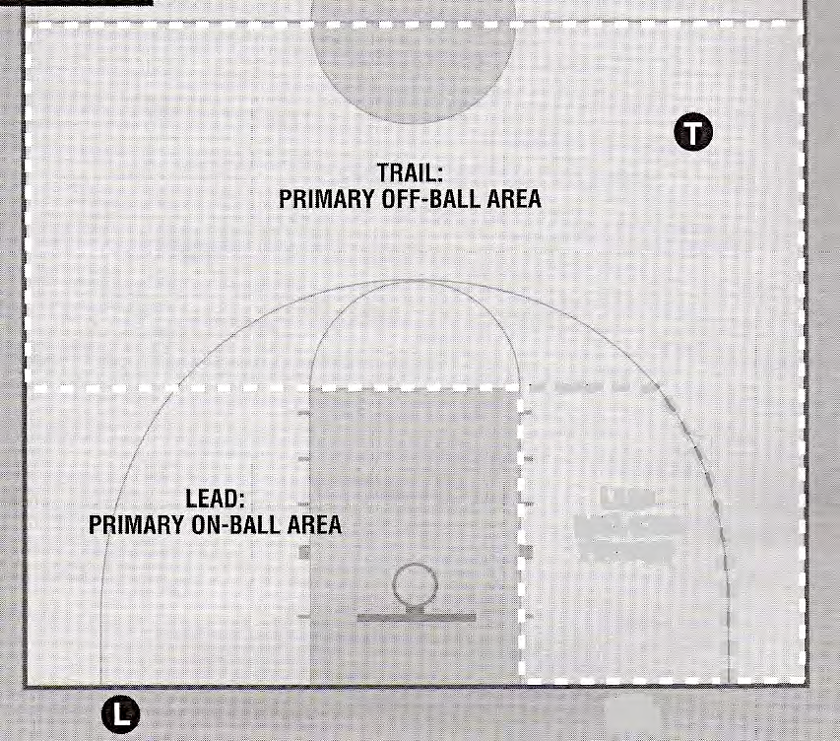
On-ball and off-ball coverage
(pg. 8- NYSGBOA – Two Person Mechanic Manual)

Slide 6
Fraternization with players and coaches
Before the game, eliminate talking to spectators and stretching out on the court.
Shake the hands of the coaching staff and vacate the bench area. If a coach wants to engage in a conversation, do your best to keep it short and move along.
Don’t let coaches/players hug you either – just tell them you can’t!

Slide 7
Delay: Any action that impedes the continuity of the game.
There are four types of DELAYS:
Repeatedly delaying the game by preventing the ball from being put in play, such as delaying the administration of a throw-in or a free throw by engaging in a huddle.
Failure to have the court ready after the final horn after timeout.
Attempting to gain an advantage by interfering with the ball after a goal.
The opponents of the thrower-in reaching through the vertical inside plane of boundary line.

Slide 8
Reporting the warning for delay
A team must be warned for each of these delays before one of the four types of delays can be penalized with a technical foul.
When reporting the delay to the table, clearly state which one of the four delays occurred and record it in the scorebook.

Slide 9
Delay
An administrative technical foul shall be called when penalizing a team after a warning has been called.
1. Repeatedly delaying the game by preventing the ball from being put in play, such as delaying the administration of a throw-in or a free throw by engaging in a huddle. (4-17.1.d & 10-2.5.b)
2. Failure to have the court ready after the final horn after timeout. (4-17.1.e & 10-2.5.c)

Slide 10
Penalty for Administrative Technical Foul
Offended team gets two shoots and the ball opposite table side. (NYS modification)
Administrative Technical fouls DO count towards the team-foul count, but not towards any individual for disqualification or ejection.

Slide 11
Delay
A player/substitute technical foul shall be called when penalizing a team after a team warning has been called.
3. Attempting to gain an advantage by interfering with the ball after a goal.
(4-17.1.f & 10-3.11)
4. The opponents of the thrower-in reaching through the vertical inside
plane of boundary line. (4-17.1.g & 10-3.7)

Slide 12
Penalty for Player/Substitute Technical Foul
Offended team gets two shoots and the ball opposite table side. (NYS modification)
Player/Substitute Technical Fouls shall apply toward individual’s five personal fouls towards disqualification, two technical fouls towards ejection and the team-foul total.
(10-3.PENALTY)

Slide 13
Reaching through the boundary
Any player from a team that reaches through the throw-in boundary plane and touches or dislodges the ball from the hands of the thrower-in or while it is being passed to a teammate outside the boundary line, as in rule 7-5.6.b. Will be called as a Player/Substitute Technical Foul.
This shall also serve as a team warning for reaching through the boundary line. (10-3.8)
If a player reaches through the boundary line and touches the thrower-in, an intentional foul shall be called. (4-29.5)

Slide 14
Thank you
Get out there and watch other officials work.
Keep working hard!

